Slide 1
Moral Hazard in the Mexican Healthcare System
Giuliana Triberti
Zixuan Zhou

Slide 2
Database
ENSANUT 2018 - INEGI
ENSANUT 2018 is the fourth full round of Mexico’s National Health and Nutrition Survey, conducted by the National Institute of Public Health (INSP) in collaboration with the National Institute of Statistics and Geography (INEGI) between July 2018 and June 2019. It delivers timely, nationally and subnationally representative data on the health and nutritional status of Mexico’s population, building on earlier surveys (2006, 2012, 2016) to track trends and inform policy.
Source: ENSANUT 2018. https://en.www.inegi.org.mx/programas/ensanut/2018/
Notes:
This is the database used
We may need to provide more info on this

Slide 3
Handling data for Mexico
Although Mexico is classified as an upper-middle-income country by the World Bank due to its Gross National Income (GNI) per capita, large segments of the population experience conditions typical of low-income settings, particularly in rural areas and among Indigenous communities. The relatively high GDP per capita is skewed by concentrated wealth and does not reflect the lived reality of many Mexicans, thereby limiting the utility of such aggregate indicators in capturing the country's development challenges. Comparing some of these states with the general Lower-middle-income countries (LMICs) figures, we can observe similarities.
State | Poverty Rate (%) | Extreme Poverty (%)
Chiapas | 67.4 | 28.2
Guerrero | 60.4 | 22.2
Oaxaca | 58.4 | 20.2
Veracruz | 54.0 | 11.4
Puebla | 52.5 | 6.5
Hidalgo | 51.7 | 13.1
Tlaxcala | 46.4 | 11.1
Tabasco | 45.1 | 9.6
Guanajuato | 44.2 | 5.1
Country | Poverty Rate (%) | Extreme Poverty (%)
Nigeria | ~63 | ~36
India | ~22 | ~10 (pre-COVID est.)
Bangladesh | ~25 | ~12
Honduras | ~53 | ~22
Pakistan | ~39 | ~21
Kenya | ~36 | ~17
Source: Consejo Nacional de Evaluación de la Política de Desarrollo Social (CONEVAL). (2023). Medición de la pobreza en México 2022. https://www.coneval.org.mx/Medicion/Paginas/PobrezaInicio.aspx
Global Data Lab. (2022). Subnational Human Development Index (SHDI) – Mexico. https://globaldatalab.org/shdi/shdi/MEX/?interpolation=0&extrapolation=0&nearest_real=0
Notes:
Since this is a class of development, we are looking into low income settings. This is the justification to use Mexico.

Slide 4
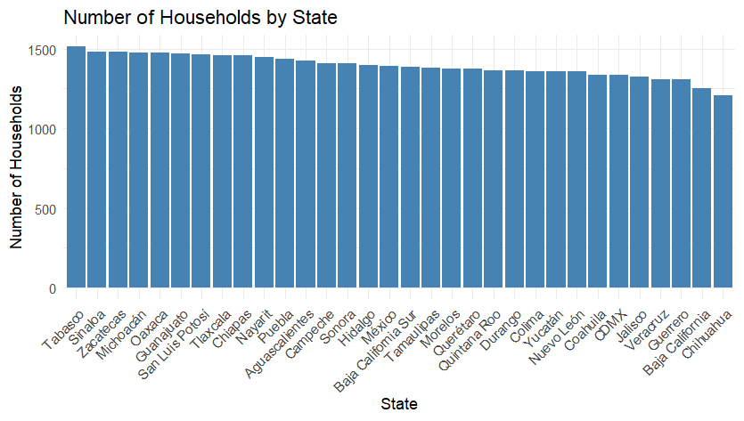
Not considering: Mexico City, Jalisco, Querétaro, Nuevo León, and Baja California
Notes:
Since the sample is divided fairly similar across states, we are not considering the highest 5 income countries.

Slide 5
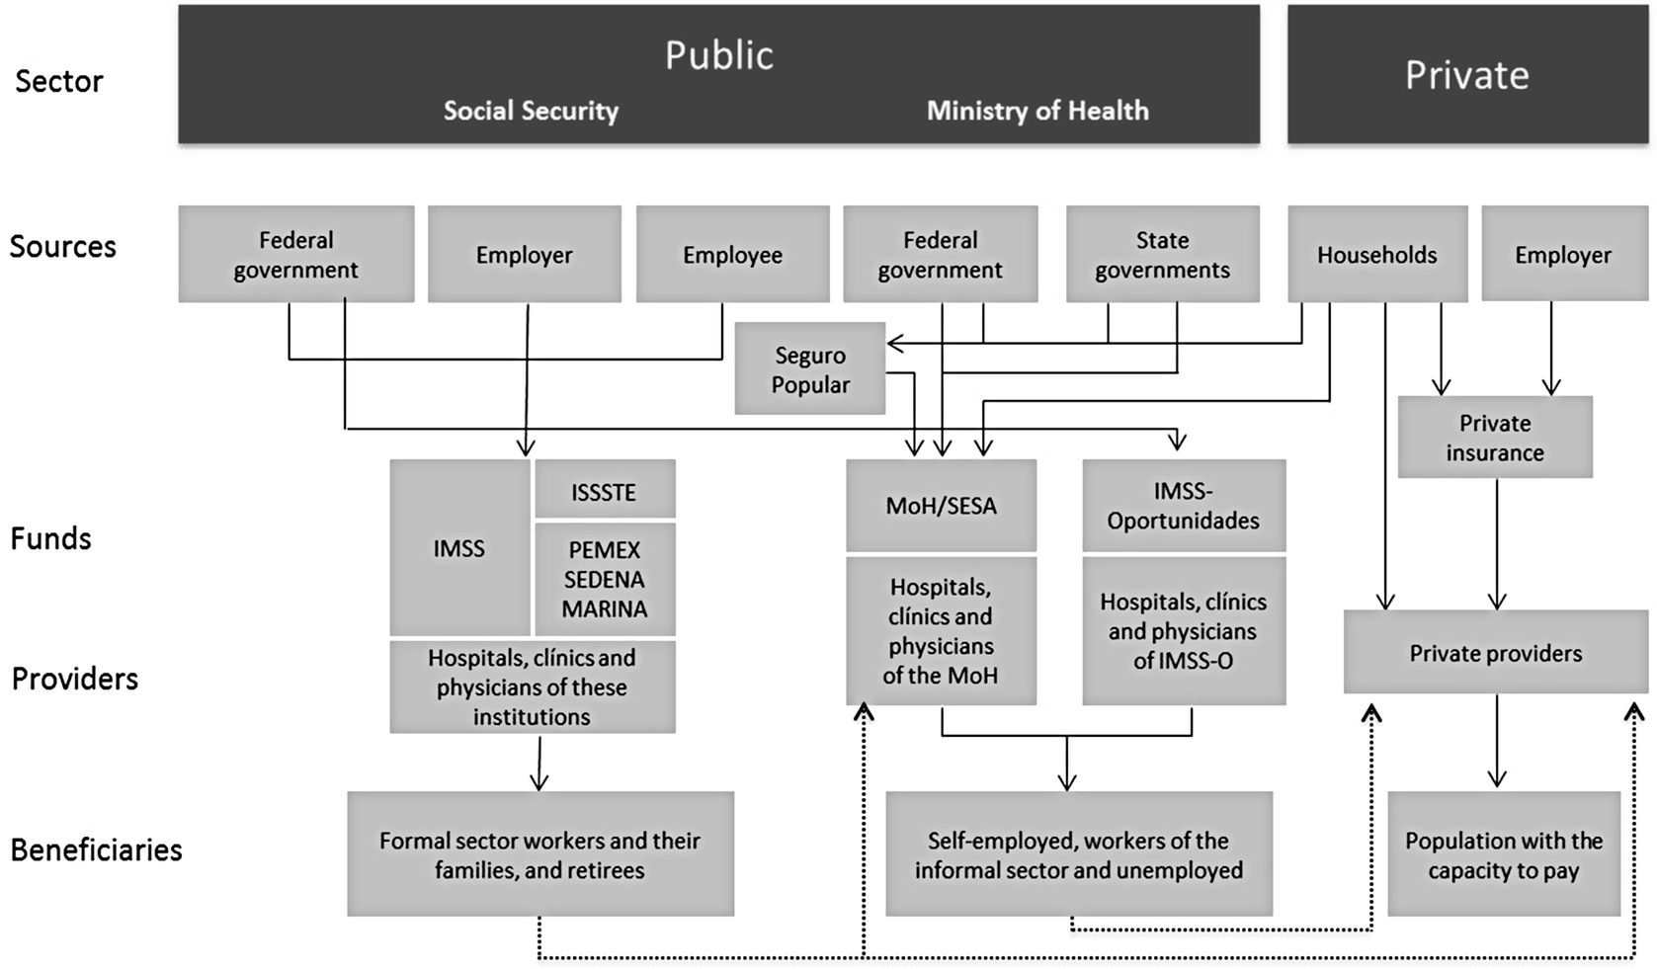
How is the Mexican Healthcare System divided?
In Mexico, assignment to a health system depends mainly on employment status and ability to pay. Formal workers and their families benefit from the Social Security System, mainly through the IMSS or ISSSTE.
For example, the ISSSTE serves workers in the State, pensioners, retirees and their entitled family members.
Notes:
It is important to denote that these are usually mutually exclusive. People in general can get attention in public clinics from the government but for coverage it is needed that the patient goes to its affiliated institute. In case of no affiliation, people go for the providers from the Ministry of Health.

Slide 6
Is this different in other countries?
No, some countries like Peru, Guatemala, Uruguay, among others also have fragmented systems https://www.sciencearena.org/en/news/fragmentation-and-inequalities-in-latin-american-healthcare-systems/
However, other similar countries have a unified system, such as Brazil https://www.commonwealthfund.org/international-health-policy-center/countries/brazil

Slide 7
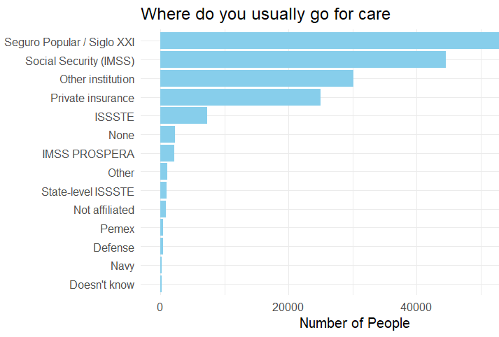
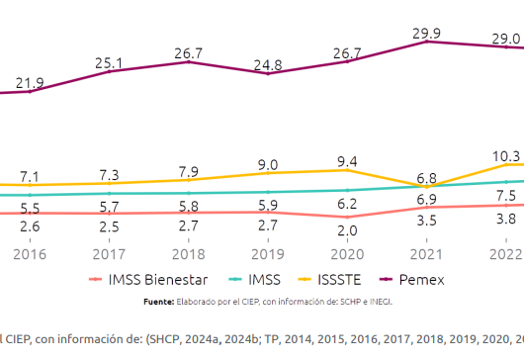
How many people go to each provider? How are resources distributed?
Expenditure per capita and Healthcare subsystem, MXN 2025
Source: https://ciep.mx/wp-content/uploads/2024/11/Gasto-para-salud-en-2025.-Recortes-en-hospitales-y-para-la-poblacion-sin-seguridad-social.pdf
Notes:
In Mexico, most people is affiliated –and usually look for care- in public institutions. Sadly, we don’t have more granular data on other institutions’ public resources per capita. However, we do have some explanations for certain institutions. The higher amount per capita goes to Pemex, which is interesting Because is one of the smallest institutions.

Slide 8
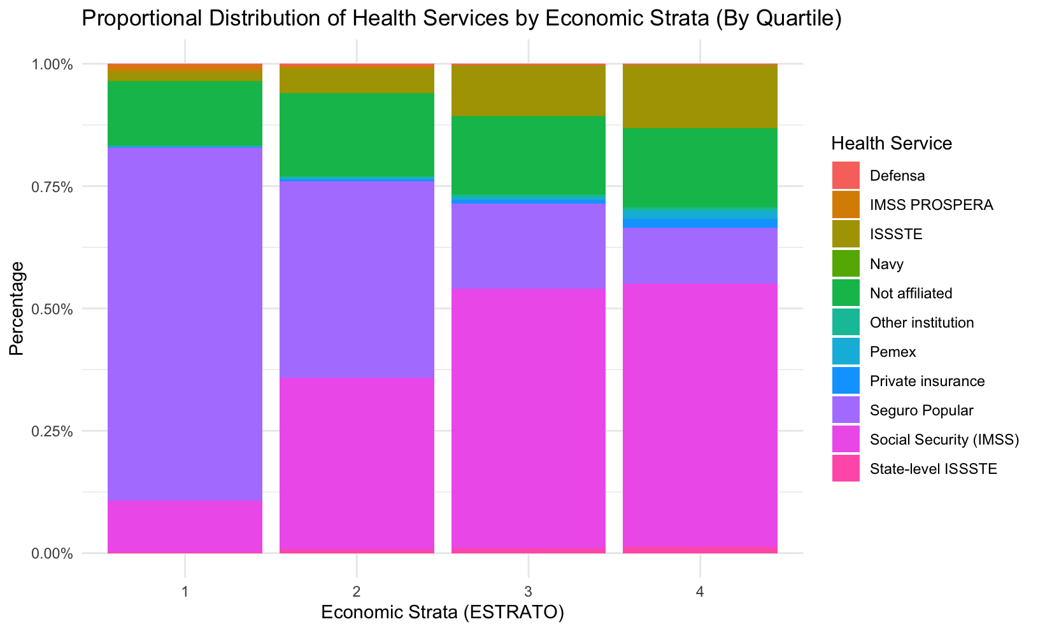
How are people divided across healthcare providers?
Notes:
Additionally, this is the economic strata of people going to each provider, were 1 is the lowest quartile and 4 is the highest.

Slide 9
How are public vs private doctors paid usually?
Public
Fixed salaries + Benefits:
Paid vacations
Health insurance
Less common (productivity bonus –per patient bonus-)
Primary incentive: Worked hours
Private
Fee-for-service + Benefits:
Productivity bonuses (number of patients goal)
Primary incentive: Reputation
Hence, our hypotheses point more towards an undertreatment problem in public health system.
Sources: http://www.scielo.org.mx/scielo.php?script=sci_arttext&pid=S0036-36342011000800017
Notes:
To understand what kind of market failure we might face, we also need the Payment structure of each of them. Since doctors in public services are paid by fixed salaries, they can be incentivized to put less effort into treatment.

Slide 10
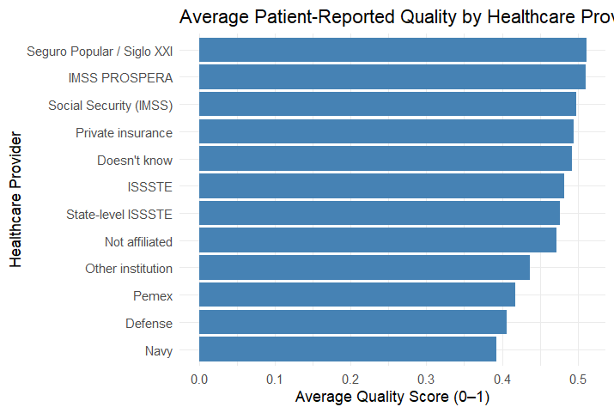
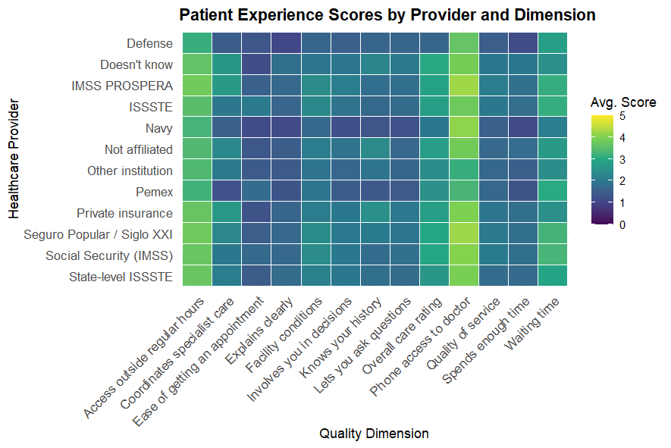
Measuring the problem: Quality measures
Healthcare quality differs greatly across public providers. We created a simple index with different dimensions to measure quality.
Apparently, all of them are similar in quality.
Notes:
As it can be observed, at first sight all of them perfom poorly in quality (in general terms).

Slide 11
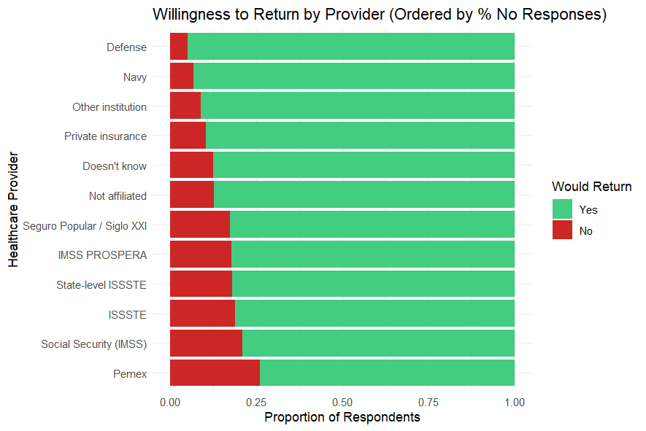
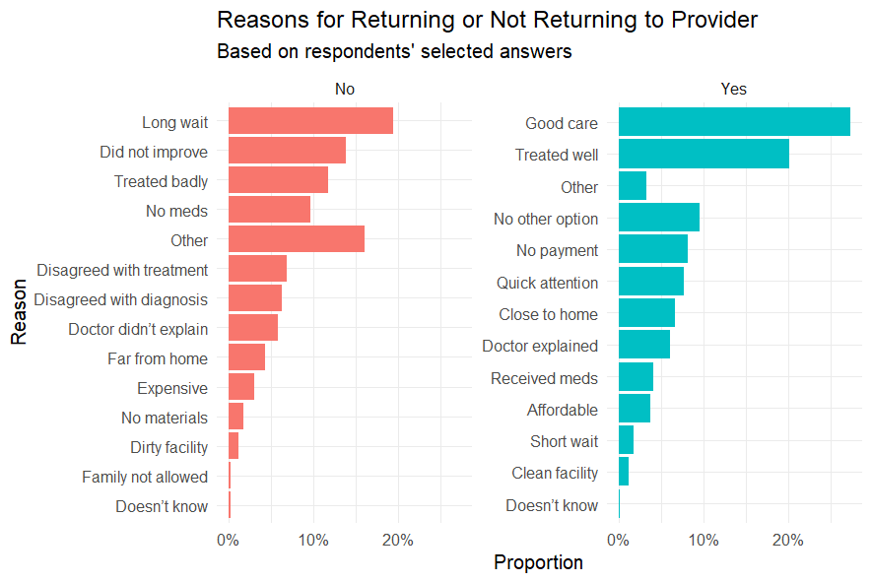
Measuring the problem: Quality measures
But one of the crucial measures of quality shows differences in return propensity. When asked why they would or wouldn’t return, these were the answers. Among the “No” options, the 3 most important are that 1) they didn’t improve, 2) they waited for long time before getting care, and 3) they were treated badly. For “Yes”, they cited good care, they were treated well, and – importantly - they do not have other options.
Notes:
However, when asked if they would return to that clinic, some people answered “No”. Here we can denote Pemex, for example, one of the institutions with highest resources per capita. Moreover, even for the people that said “Yes” There is a good percentage that says they “Don’t have other option”, and among the “No”, a good percentage said they “Did not improve” after treatment.

Slide 12
The problem: Healthcare quality differs across public providers
The main issue in the healthcare system stems from its high degree of fragmentation. This fragmentation leads to misaligned incentives and various market failures, including:
Disparities in the public allocation of resources, which contribute to:
Declining healthcare quality
Unequal access to care
High out-of-pocket expenditures
Corruption, which results in:
Misappropriation of funds
Further inequality in healthcare access
Violations of labor rights
Moral hazard behavior in doctors:
Excessive / Insufficient testing
High out-of-pocket expenditures
Overtreatment / Undertreatment
While our primary focus will be on the moral hazard behavior, we will also briefly discuss the first and second—particularly regarding unequal access to healthcare. The disparities in public allocation resources has been studied before thoroughly (PUT ARTICLES HERE). People from higher quality providers also pay more on taxes, so it’s difficult to make a clear link. The corruption market failure is challenging to study since we don’t have granular data.
Notes:
This makes us think of these possible market failures. The first one has been studied broady before and from the data, it is not clear that quality is strictly linear with the resources provided (this could have important confouders such as the amount of taxes paid). Corruption, which is another important problem in analyzing incentives, is difficult to study Because we don’t have clear data on it. Finally, with the data we have, we will study moral Hazard behavior in doctors. This means that doctors can modify their behavior depending on their own incentives, causing problems on the health quality of patients.

Slide 13
Research question
Does moral hazard among doctors in the Mexican healthcare system lead to substantial differences in healthcare quality?
Notes:
Hence, the main question is the following

Slide 14
Market failure: Moral Hazard explanation (put this text in notes and change for images)
Goverment (the principal) wants to deliver Healthcare to its citizens and have Universal Health Coverage. The principal has the structure (Providers).
However, since it cannot deliver everything to everyone, they have these intermediaries (doctors) who evaluate each individual health and prescribe treatment. These doctors are the agents.
Recall that, in the public sector, agents are paid by base income. In private sectors, doctors are paid by serve provided (https://saludpublica.mx/index.php/spm/article/view/5761/6382).
Since these agents are difficult to monitor (since medical knowledge can be diverse) they can undertreat and show “less effort” Because they will have a Payment anyways.
Undertreatment is aligned with low health outcomes, it is also aligned with low propensity to return with that doctor/clinic, leading to a market failure for the Government because they cannot deliver to citizens good health quality.
Undertreatment, particularly in a medical context, implies that a patient or condition is not receiving the necessary or recommended treatment for a specific illness, injury, or ailment. This can be due to various factors, including misdiagnosis, lack of access to care, or ineffective treatment strategies.
Notes:
To explain it clearly. This is the moral Hazard explanation.

Slide 15
Hypotheses to prove market failure
What we want to prove: The possibility of health care providers abusing a system in order to ‘reduce effort’ at the expense of consumers, providers, or the system in general.
1. With fixed salaries and low monitoring, providers may induce less services.
2. With fixed salaries and low monitoring, providers spend less effort per patient.
3. Moral hazard leads to inefficient care. (Data: if they got better after treatment)
4 If doctors don’t care on getting more patients because they will be paid anyways, this leads to longer wait times and less appointment availability.
5. People not getting the treatment as expected in hospital are also related to usually get treated in private systems or alternative medicine
Moral hazard can lead to the misuse of healthcare resources, like medications, hospital beds, or staff time, ultimately affecting the availability of services for those who truly need them, or increasing spending for this specific provider. If this is the case, allocation of resources across other patients inside this system and pertaining to other might face difficulties.
Notes:
To prove this is the market failure, we have some hypotheses.

Slide 16
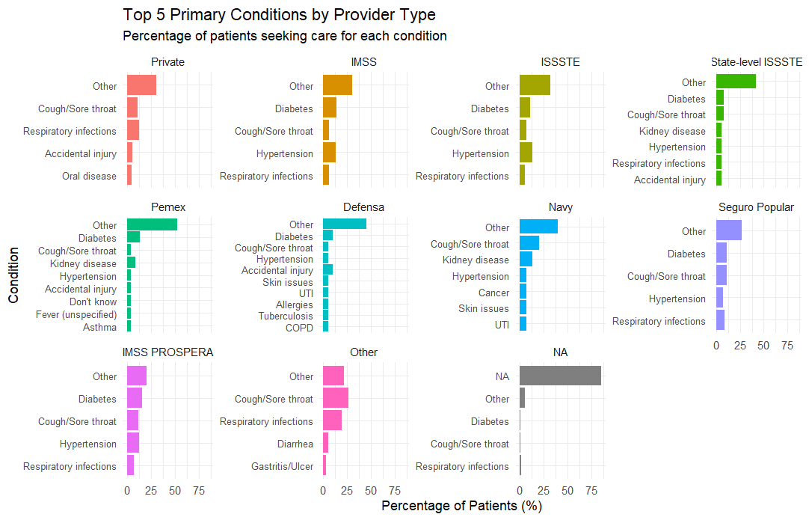
Before starting: Do they have different health conditions across providers? (CHECK)
Notes:
Before starting with the tests, it is important to denote that all services have similar common conditions and that they do not vary widely across providers.

Slide 17
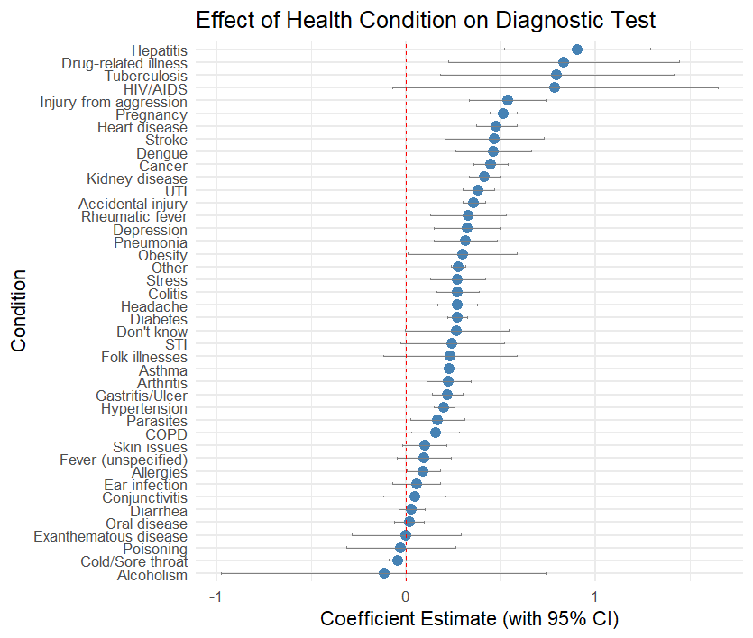
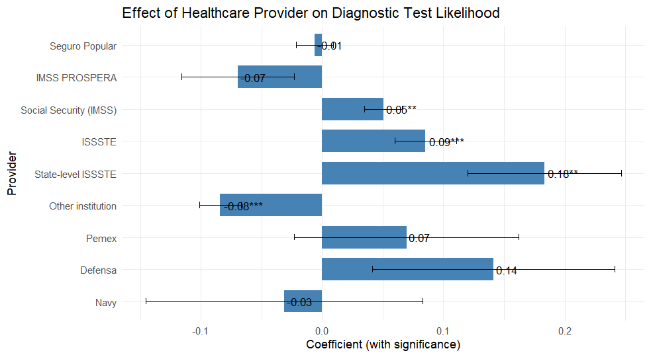
Hypothesis 1
With fixed salaries and low monitoring, providers may induce less services and medicine prescription.
Base comparison= Private (since they don’t get fixed income)
Notes:
For the first hypothesis we first test the probability of get a test prescribed by the Healthcare provider. We are comparing all of them with the Private insurance since they do not have fices income (so it can work as a counterfactual). We include variables such as conditions, age, and sex. Most conditions were significant into getting a higher change of test prescription. Additionally, some institutions proved to be statistically significant in having more likelihood to request a test.

Slide 18
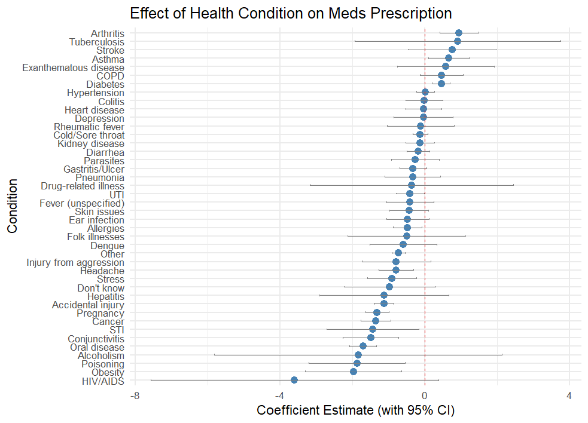
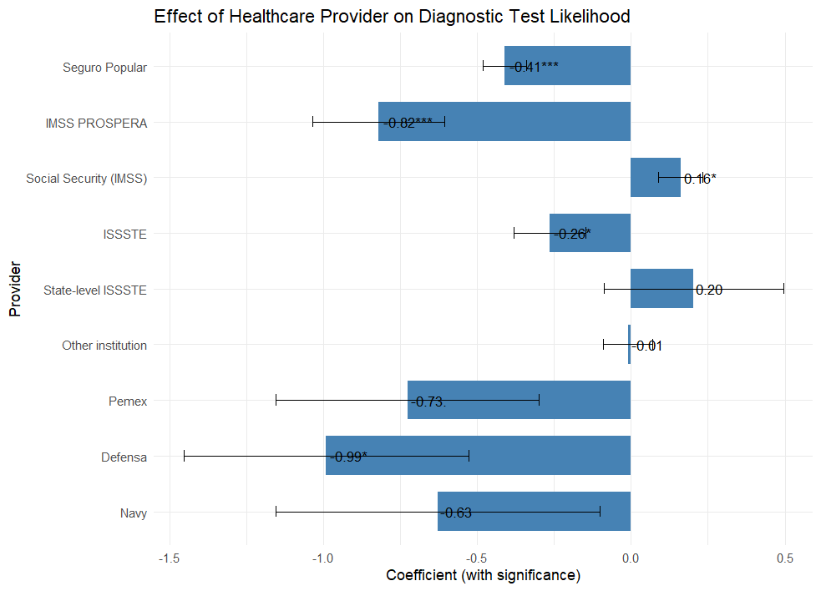
Hypothesis 1
Notes:
In the case of number of medications prescribed, most conditions didn’t proved to be significant. However, some of the institutions gave statistically less medication in comparison to the private insurance (Seguro Popular, ISSSTE, Defensa, IMSS Prospera).

Slide 19
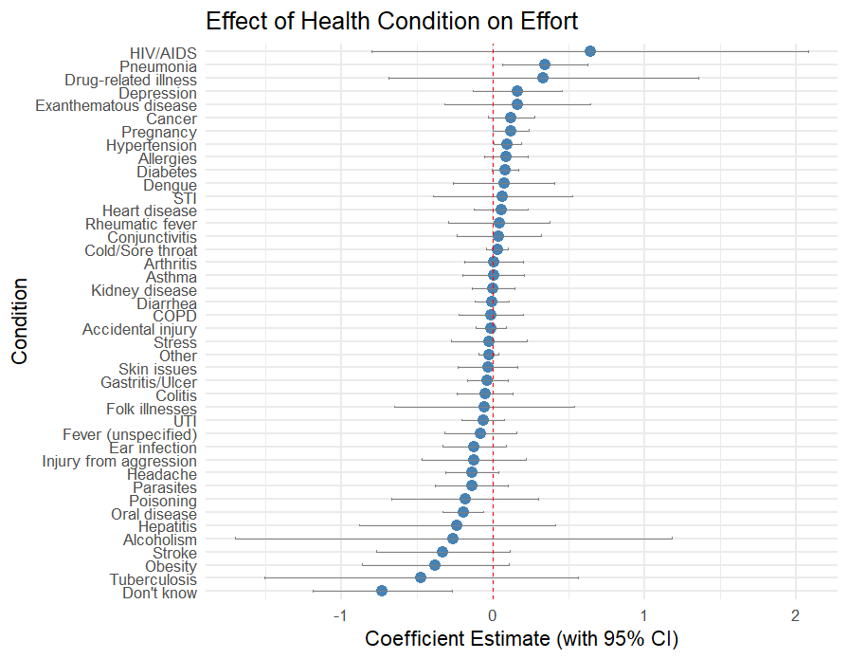
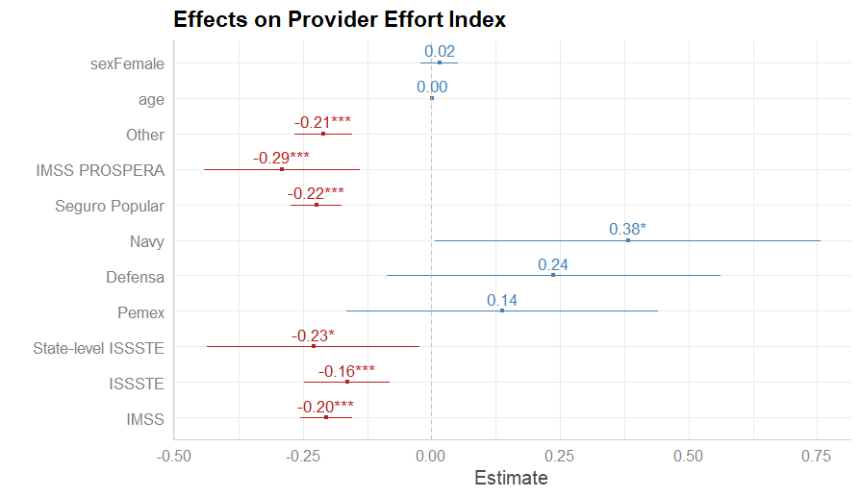
Hypothesis 2
With fixed salaries and low monitoring, doctors apply less effort per treatment.
Base comparison= Private (since they don’t get fixed income)
Notes:
For the second Hypothesis we see that the conditions is not statistically related to the effort doctors provide, but they are statistically significant in a good amount of Institutions. It is important to denote that in the appendix you can find the variables that we used for the effort index.

Slide 20
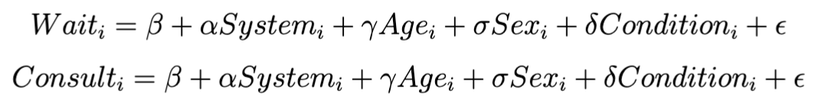
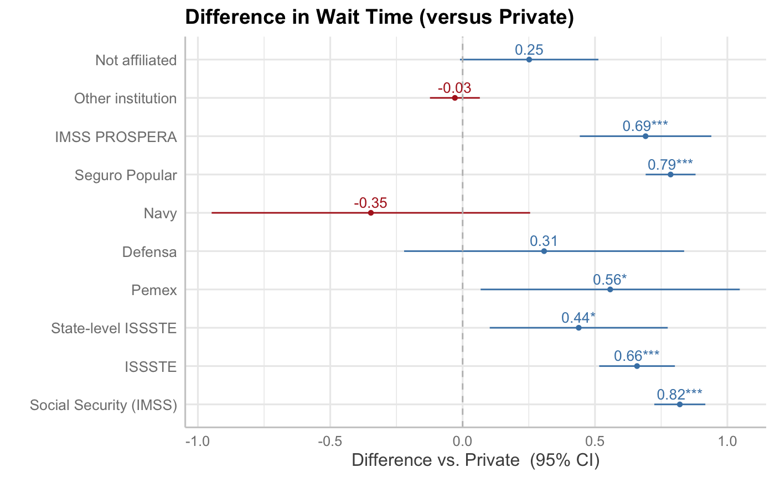
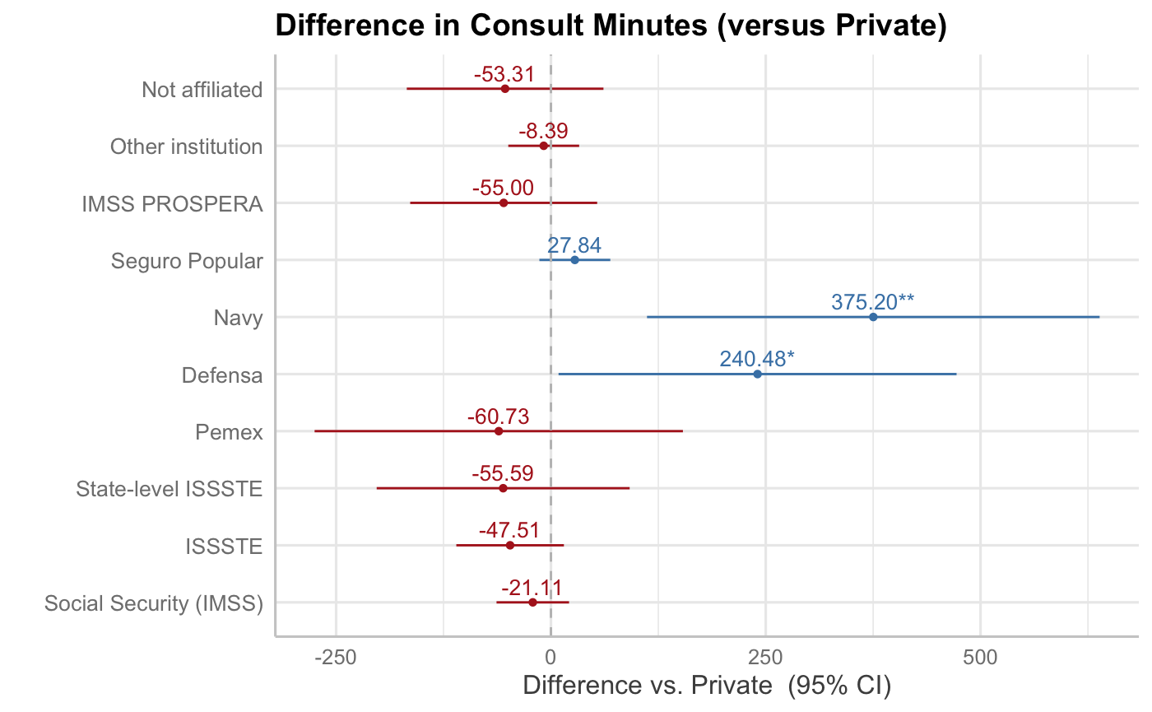
Hypothesis 3
Comparing with private healthcare services, public ones has significantly longer wait times and less consultation minutes.
Notes:
Hypothesis 4 compares wait times and consult minutes across different public healthcare systems to private ones. We can see that public healthcare systems has significantly longer wait times, and shorter consultation minutes with doctors (though the difference is not significant for consultation time) >> another signal that public healthcare is not efficient.
I think this should be put forward.

Slide 21
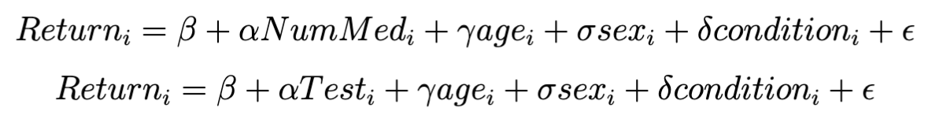
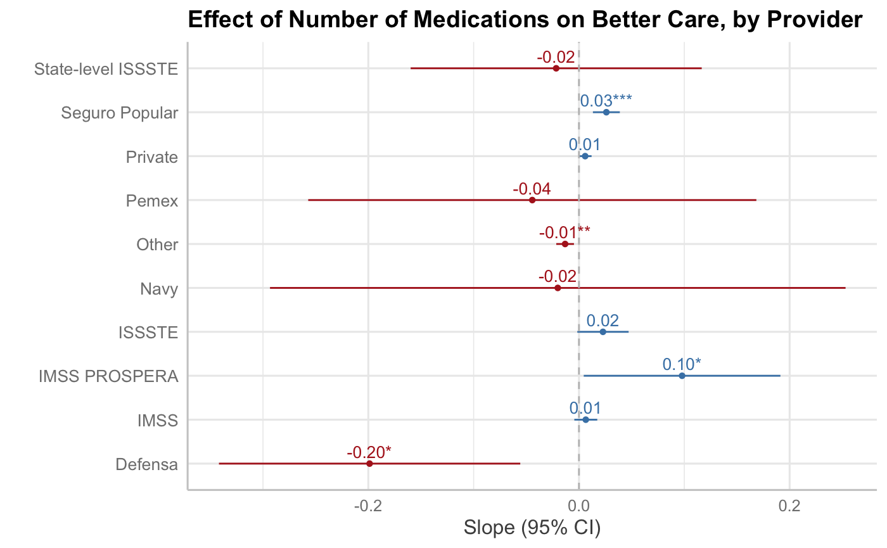
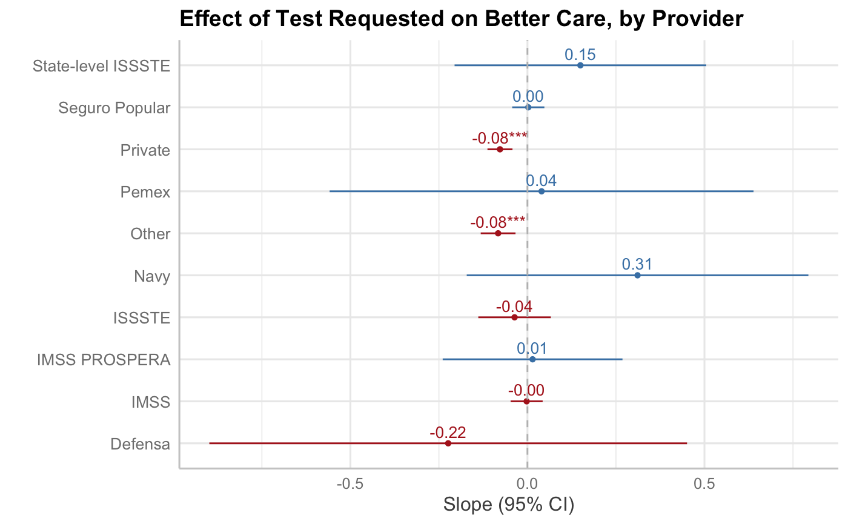
Hypothesis 4
Moral hazard leads to inefficient care, not better care - prescribing more medication/tests does not necessarily improve patient’s willingness to return
For each provider, we estimate:
Notes:
Hypothesis 3 asks what is the effect of providing more medical services (measured by number of medications and tests) on patients’ willingness to return to the same hospital, should they become sick next time. The effect sizes are generally very small and not significant. Therefore, providing more tests might not necessarily improve patients’ willingness to return - this suggests that even in cases where more medical services are provided, the quality of care does not necessarily improve.
*We ask these questions because in a well-functioning system, more tests usually mean the doctors try hard to find out what’s wrong with the patients and generally indicate more comprehensive evaluation, which will likely help patients determine their illnesses. This should mean better service - patients are therefore more likely to return to the same hospital.

Slide 22
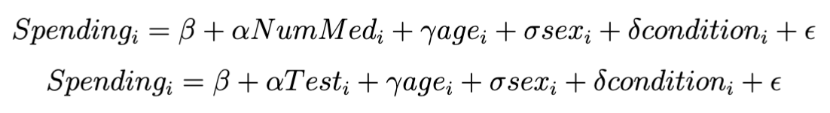
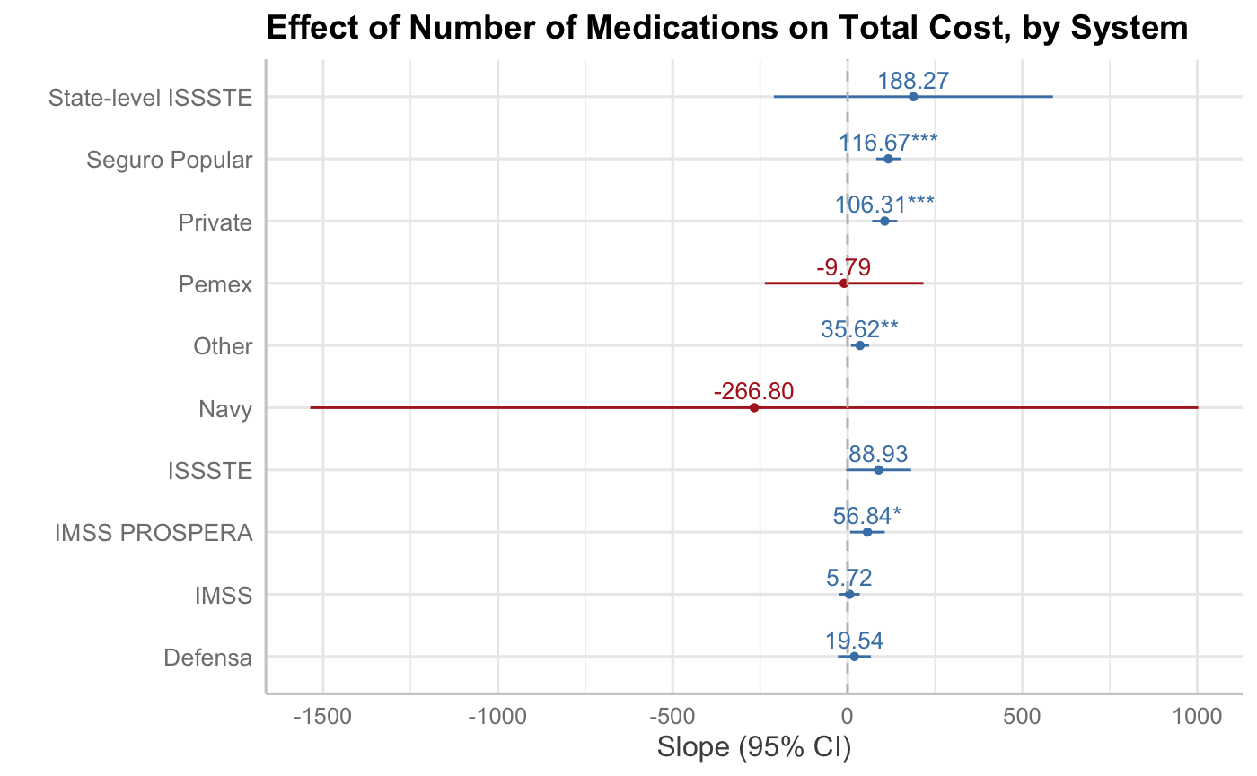
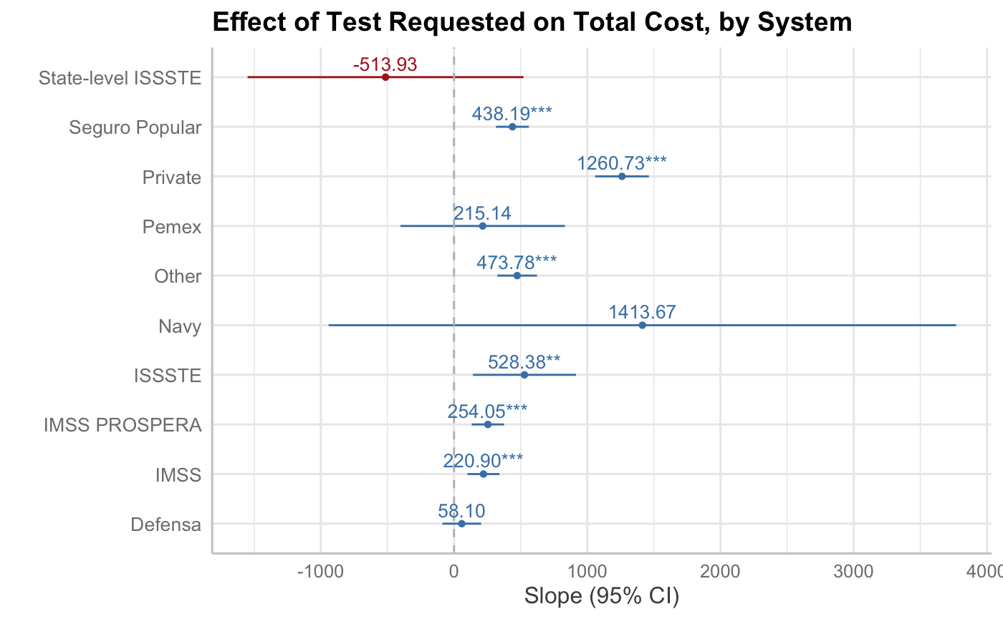
Hypothesis 4 Cont.
… But prescribing more medication/tests incur extra medical spending for patients!
For each provider, we estimate:
Notes:
Although the mexican public healthcare system is generally free, certain “out-of-the-pocket” payment still exists. This slide shows that “overtreatment” through providing more medication and tests do incur extra costs for the patients, even in public healthcare systems. Combined with the last slide, we know that more care does not mean better care, but they inevitably bring financial burdens for the patient. From the patient end, this means higher input with little return - which supports our inefficiency hypothesis. (Patients spent more money but is not better-off)
Note that this is true for private healthcare as well.

Slide 23
Doctor Shortage
https://www.thelancet.com/journals/lanam/article/PIIS2667-193X(24)00293-X/fulltext
Not moral hazard but also explains longer wait times and shorter consultation time.

Slide 24
Problem Summary
We found evidence that there is moral hazard in doctors within the Mexican healthcare system:
Propensity of prescribing more tests, not medication + tests (instead of medication) incurs higher out-of-pockets fees
What leads to this moral hazard? (our story is that we observe inefficiency, which is caused by moral hazard; but what causes moral hazard?)
Probably not pay structure (extra patient payment does not translate to salary bonus)
Possibly, fear of malpractice
Lack of treatment guideline causing doctors to prescribe tests blindly
Gray income: patient bribes making doctors more pressured to act like they put a lot of effort (prescribing more tests) when they actually do not
Notes:
Our solution should be more focused on these problems!

Slide 25
Solution
Addressing Moral Hazard: Mechanisms to reduce moral hazard include:
Patient cost-sharing: Requiring patients to pay a portion of the cost of their healthcare can encourage more responsible utilization of services.
Transparent pricing and information: Providing clear and accurate information about the costs and benefits of different treatment options can empower patients to make informed decisions.
Stronger ethical oversight: Enforcing ethical guidelines and providing clear standards for medical practice can help to prevent inappropriate or unnecessary care.
Incentivizing preventative care: Rewarding doctors for promoting and delivering preventative care can help to address long-term health problems and reduce the demand for treatment later on.
One way to reduce moral hazard is to make patients pay a part of the cost of health care, either as a fixed amount (co-payment) or as a percentage of the total bill (deductible). This can discourage unnecessary or excessive use of health services and encourage preventive care. However, co-payments and deductibles can also create barriers to access for low-income or vulnerable groups, and may reduce the quality of care if patients delay or avoid seeking treatment.

Slide 26
Appendix
Quality index variables
Additional figures

Slide 27
Variables for the Provider Quality Index
Variable | Question | Response Scale
P3_5 | The service provided was… | Likert 1–5 (1 = Very good)
P4_6 | The time you waited before receiving attention was… | Likert 1–5 (1 = Very long)
P7_2 | If you had a choice, would you go back to that same place for care? | Yes/No
P7_7 | How are the conditions of the place where you received healthcare? | Likert 1–5 (1 = Very bad conditions)
P8_2 | How quickly were you able to make an appointment when you were sick or needed care? | Likert 1–5 (1 = Very easy)
P8_3 | How easy is it to receive medical care at night/weekends/holidays without going to the hospital? | Likert 1–5 (1 = Very easy)
P8_4 | How easy is it to phone your doctor during office hours and get the answer you need? | Likert 1–5 (1 = Very easy)
P8_5_1 | How often does your doctor/staff know important info about your medical history? | Likert 1–5 (1 = Always)
P8_5_2 | How often does your doctor/staff offer you the opportunity to ask questions? | Likert 1–5 (1 = Always)
P8_5_3 | How often does your doctor/staff spend enough time with you? | Likert 1–5 (1 = Always)
P8_5_4 | How often does your doctor/staff involve you in decisions about your care? | Likert 1–5 (1 = Always)
P8_5_5 | How often does your doctor/staff explain things in an easy-to-understand way? | Likert 1–5 (1 = Always)
P8_5_6 | How often does your doctor/staff help coordinate specialist care? | Likert 1–5 (1 = Always)
P8_6 | Overall, how would you rate the medical care you received in the past 12 months? | Likert 1–5 (1 = Excellent)
P8_8_1 | In the past 12 months, did your doctor/staff review the medicines you take? | Yes/No
P8_8_2 | In the past 12 months, did your doctor/staff explain potential medication side effects? | Yes/No
P8_8_3 | In the past 12 months, did your doctor/staff provide a written list of prescriptions? | Yes/No

Slide 28
Variables for effort index

